Slide 1
Images
CS 4150/6050: Computer Vision

Slide 2
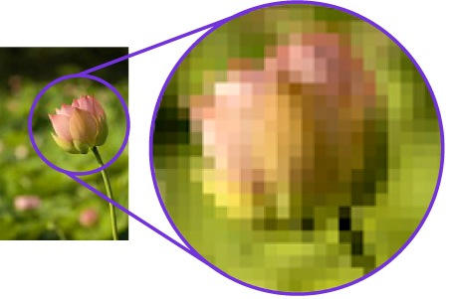
Digital Images
Each pixel has 3 values for red, green and blue
First question is what is the image resolution?
Most digital images are stored as a grid of color values
called “pixels” (short for picture elements)

Slide 3
Grayscale Images
Let’s start with this because it is easier to think about.
A grayscale image is a matrix of values that represent the shade.
  8-bit standard: 0 = black, 255 = white
0 | 0 | 100 | 0 | 0 | 100 | 0 | 0
0 | 0 | 255 | 0 | 0 | 255 | 0 | 0
0 | 0 | 255 | 0 | 0 | 255 | 0 | 0
0 | 0 | 150 | 0 | 0 | 150 | 0 | 0
0 | 255 | 0 | 0 | 0 | 0 | 255 | 0
0 | 180 | 255 | 255 | 255 | 255 | 180 | 0
0 | 0 | 180 | 200 | 200 | 180 | 0 | 0
0 | 0 | 0 | 0 | 0 | 0 | 0 | 0

Slide 4
Grayscale Images
Let’s start with this because it is easier to think about.
A grayscale image is a matrix of values that represent the shade.
  8-bit standard: 0 = black, 255 = white

Slide 5
Color Images
Color images are usually stored with 3 or more matrices, each matrix representing a different channel of color.
Blue Component
Red Component
Green Component
0 | 0 | 100 | 0 | 0 | 100 | 0 | 0
0 | 0 | 255 | 0 | 0 | 255 | 0 | 0
0 | 0 | 255 | 0 | 0 | 255 | 0 | 0
0 | 0 | 150 | 0 | 0 | 150 | 0 | 0
0 | 255 | 0 | 0 | 0 | 0 | 255 | 0
0 | 180 | 255 | 255 | 255 | 255 | 180 | 0
0 | 0 | 180 | 200 | 200 | 180 | 0 | 0
0 | 0 | 0 | 0 | 0 | 0 | 0 | 0
185 | 185 | 0 | 185 | 185 | 0 | 185 | 185
185 | 185 | 0 | 185 | 185 | 0 | 185 | 185
185 | 185 | 0 | 185 | 185 | 0 | 185 | 185
185 | 185 | 0 | 185 | 185 | 0 | 185 | 185
185 | 0 | 185 | 185 | 185 | 185 | 0 | 185
185 | 0 | 0 | 0 | 0 | 0 | 0 | 185
185 | 185 | 0 | 0 | 0 | 0 | 185 | 185
185 | 18 | 185 | 185 | 185 | 185 | 185 | 185
120 | 120 | 100 | 120 | 120 | 100 | 120 | 120
120 | 120 | 255 | 120 | 120 | 255 | 120 | 120
120 | 120 | 255 | 120 | 120 | 255 | 120 | 120
120 | 120 | 150 | 120 | 120 | 150 | 120 | 120
120 | 255 | 120 | 120 | 120 | 120 | 255 | 120
120 | 255 | 255 | 255 | 255 | 255 | 255 | 120
120 | 120 | 255 | 255 | 255 | 255 | 120 | 120
120 | 120 | 120 | 120 | 120 | 120 | 120 | 120
,
,

Slide 6
RGB Color Model
Simplest model is just to store red, green, and blue values
Colors can be thought of as points in a RGB cube
Example: [255, 0, 255] = Purple
More on this later…

Slide 7
Image Storage
Grayscale Images
  Single Matrix
  Data = rows x columns
Color Images
  Multiple Matrices (a.k.a Tensor)
  Data = rows x columns x colors

Slide 8
Vocabulary
0 Dimensions | Number, Scalar
1 Dimension | List, Vector, Array
2 Dimensions | Grid, Matrix
3+ Dimensions | Tensor

Slide 9
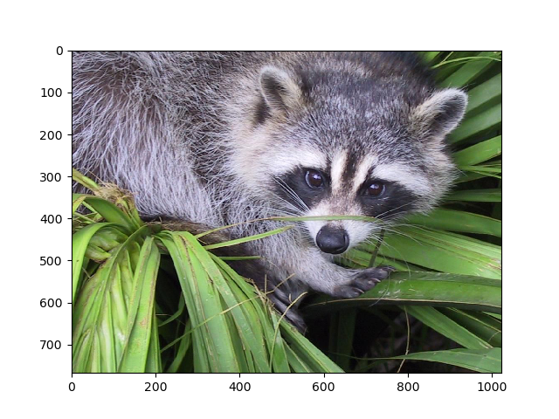
Images in Python
We will use three major packages in this class for images:
NumPy – Matrix and Tensor Processing
Matplotlib – Image Loading, Saving, and Displaying
OpenCV – Computer Vision Algorithm Library

Slide 10
Live Demo: Loading Images
1. conda create --name compvis3a python=3.12
Use the above to install an environment in pc so all installations here don’t affect the base python and versions of the general pc.
2. conda activate compvis3a
To activate and start using the environment

Slide 11
Coming up...
Raster displays
  How does a screen display an image using stored color values?

